Slide 1
Data Mining: Advanced Techniques Machine Learning
主讲教师: 陈佳伟, sleepyhunt@zju.edu.cn
https://jiawei-chen.github.io/
TA: 陈德仿, defchern@zju.edu.cn

Slide 2
Outline
6th lesson: Basic Machine Learning
7th lesson: Graph Mining
8th lesson: Recommender Systems
2
Notes:
2

Slide 3
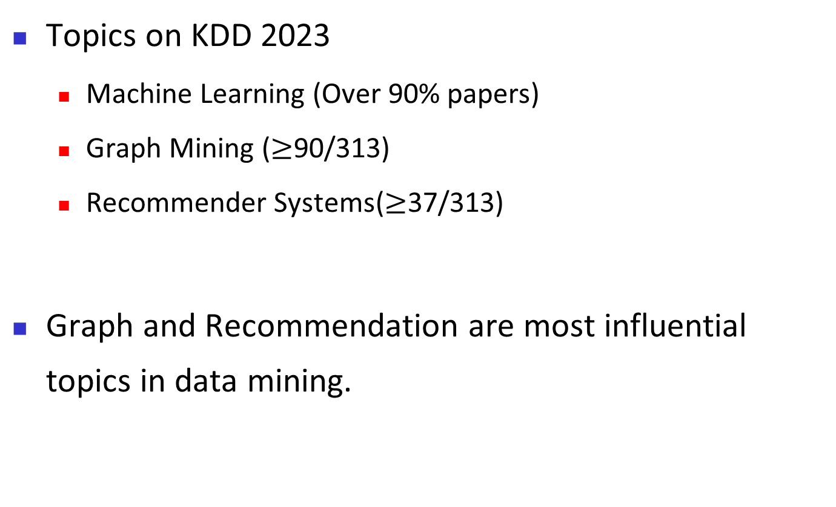
Why these topics?
Topics on KDD 2023
Machine Learning (Over 90% papers)
Graph Mining ($≥$90/313)
Recommender Systems($≥$37/313)
Graph and Recommendation are most influential topics in data mining.
3
Notes:
3

Slide 4
Why these topics?
Top-10 most influential papers in KDD 2022
1. GraphMAE: Self-Supervised Masked Graph Autoencoders
2. Graph Attention Multi-Layer Perceptron
3. Learned Token Pruning for Transformers
4. GraphWorld: Fake Graphs Bring Real Insights for GNNs
5. Contrastive Cross-domain Recommendation in Matching
6. Graph Neural Networks for Multimodal Single-Cell Data Integration
7. Proton: Probing Schema Linking Information from Pre-trained Language Models for Text-to-SQL Parsing
https://www.paperdigest.org/2023/04/most-influential-kdd-papers-2023-04/
4
Notes:
4

Slide 5
Why these topics?
Top-10 most influential papers in KDD 2022
8. Graph-Flashback Network for Next Location Recommendation
9. TwHIN: Embedding The Twitter Heterogeneous Information Network for Personalized Recommendation
10. FederatedScope-GNN: Towards A Unified, Comprehensive and Efficient Package for Federated Graph Learning
https://www.paperdigest.org/2023/04/most-influential-kdd-papers-2023-04/
5
Notes:
5
这些文章基本都落在机器学习范畴内，大部分都涉及图或推荐系统。

Slide 6
Why these topics?
What can we obtain from these lessons?
Basic knowledge about machine learning, recommender systems and graph mining
Some promising directions on these topics
Something about how to do research
Get the credits
6
Notes:
6
这些文章基本都落在机器学习范畴内，大部分都涉及图或推荐系统。

Slide 7
Basic Machine Learning
Machine learning: basic concepts
Types of learning
Foundation of machine learning
Promising directions
7
Notes:
7

Slide 8
What is machine Learning?
“Learning is any process by which a system improves performance from experience” - Herbert Simon
Definition by Tom Mitchell (1998)
Machine Learning is the study of algorithms that
improve their performance P
at some task T
with experience E
Slide credit: Eric Eaton
Notes:
机器学习是基础。

Slide 9
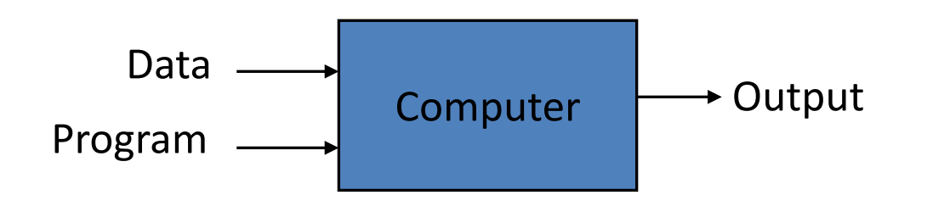
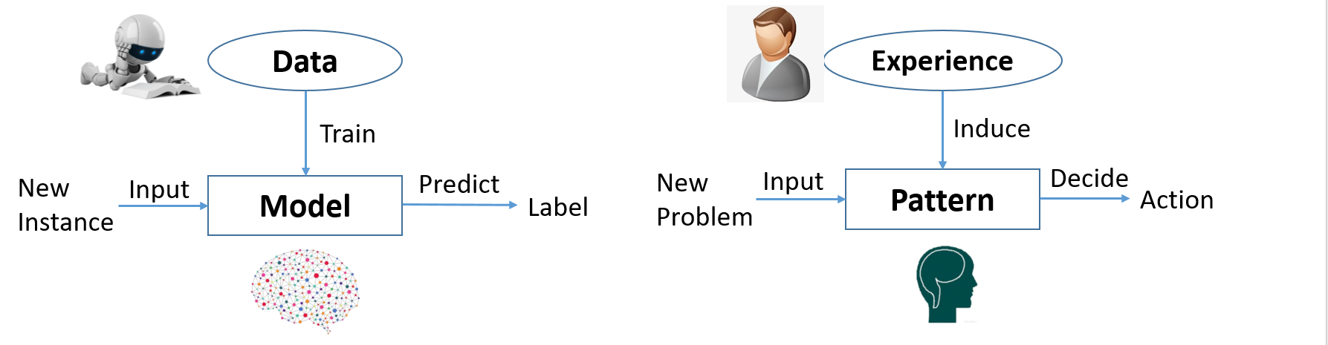
Why machine Learning?
Traditional Programming
Expertise
Rules
Machine Learning
Intelligence: does not need human explicit programming
Universality: can handle complex data and diverse tasks
Notes:
机器学习是基础。

Slide 10
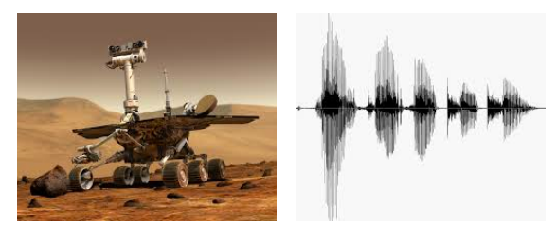

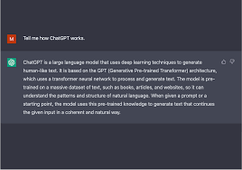
When Do We Use Machine Learning?
ML is used when:
Human expertise does not exist (navigating on Mars)
Humans can’t explain their expertise (speech recognition)
Models must be customized (personalized recommendation)
Models are based on huge amounts of data (conversation)
Slide credit: Eric Eaton
Notes:
机器学习是基础。

Slide 11
Basic Machine Learning
Machine learning: basic concepts
Types of learning
Foundation of machine learning
Promising directions
11
Notes:
11

Slide 12
Basic Machine Learning
Supervised learning
– Given: training data + desired outputs (labels)
Unsupervised learning
– Given: training data (without desired outputs)
Reinforcement learning
– Rewards from sequence of actions
Slide credit: Eric Eaton
12
Notes:
12

Slide 13
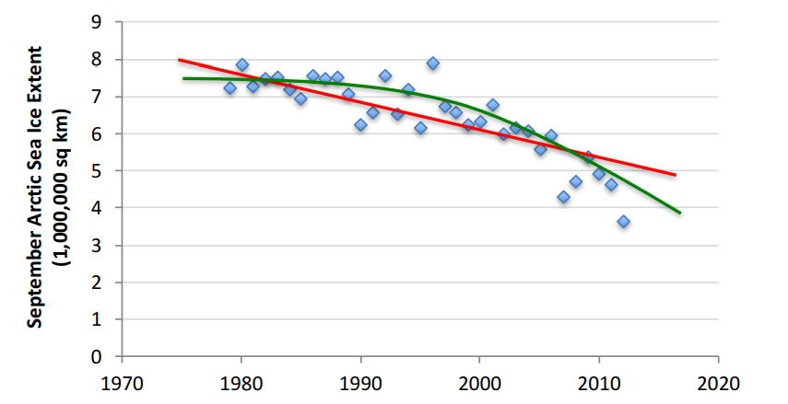

Supervised learning: Regression
Given $(x_{1},y_{1}), (x_{2},y_{2}), …, (x_{n},y_{n})$
Learn a function $f(x)$to predict $y$ given $x$
$y$ is real-valued
Slide credit: Eric Eaton
13
Notes:
13

Slide 14
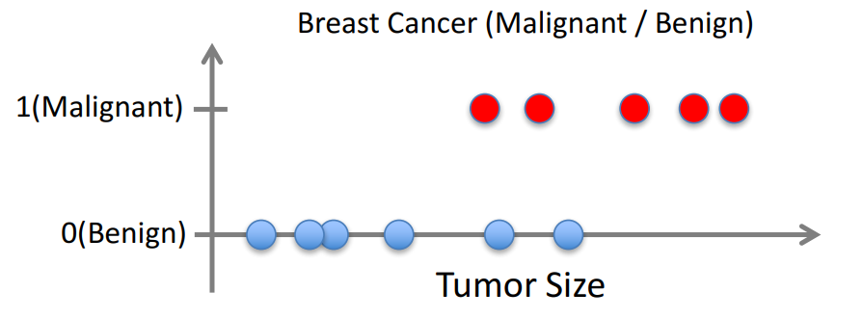

Supervised learning: Classification
Given $(x_{1},y_{1}), (x_{2},y_{2}), …, (x_{n},y_{n})$
Learn a function $f(x)$to predict $y$ given $x$
$y$ is categorical
Slide credit: Eric Eaton
14
Notes:
14

Slide 15
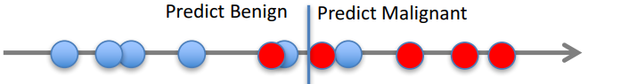
Supervised learning: Classification
Given $(x_{1},y_{1}), (x_{2},y_{2}), …, (x_{n},y_{n})$
Learn a function $f(x)$to predict $y$ given $x$
$y$ is categorical
Slide credit: Eric Eaton
15
Notes:
15

Slide 16
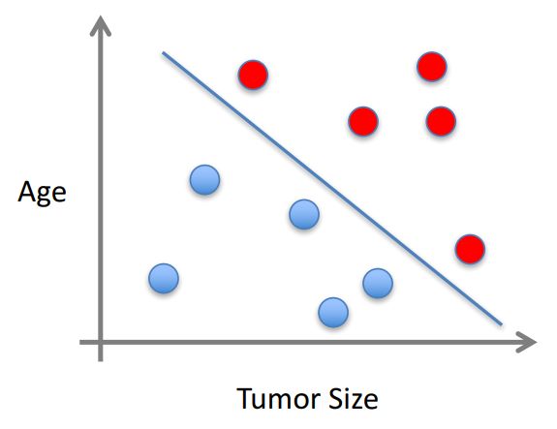

Supervised learning
$x$ can be multi-dimensional
Each dimension corresponds to an attribute
- Clump Thickness
- Uniformity of Cell Size
- Uniformity of Cell Shape
Slide credit: Eric Eaton
16
Notes:
16
一致性

Slide 17
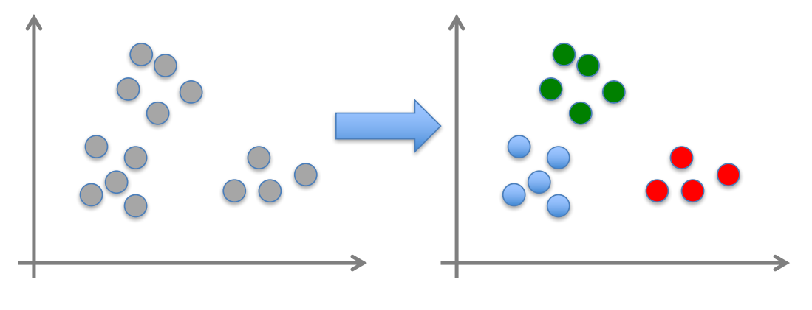

Unsupervised learning
Given${ x}_{1},x_{2}, …,x_{n}$(without labels)
Output hidden structure behind the x’s
Clustering
Learning Representation
Slide credit: Eric Eaton
17
Notes:
17
一致性

Slide 18
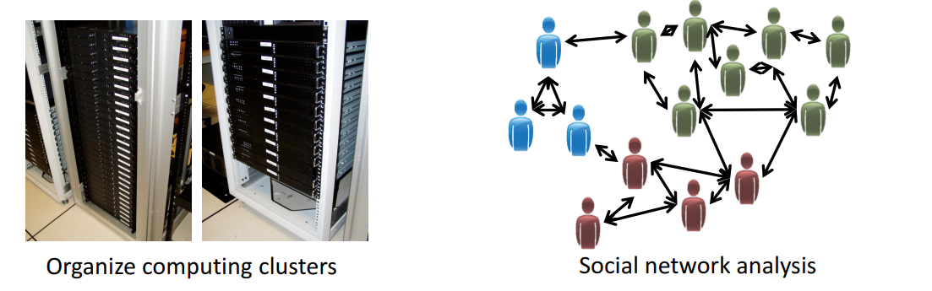
Unsupervised learning: Clustering
Clustering: some examples
Slide credit: Eric Eaton
18
Notes:
18
一致性

Slide 19
Unsupervised learning: Representation
Learning representation from the data
---Self-supervised learning:
Obtain “labels” from the data itself by using a “semiautomatic” process.
Predict part of the data from other parts.
“Construct a supervised task from the data”
TKDE’21: Self-supervised Learning: Generative or Contrastive
19
Notes:
19
一致性

Slide 20
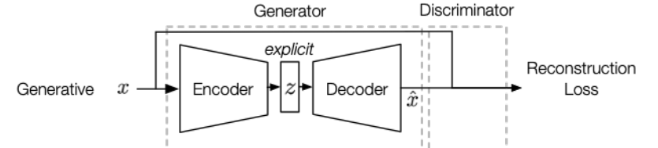

Unsupervised learning: Representation
Generative models:
train an encoder to encode input $x$ into an explicit vector $z$ and a decoder to reconstruct $x$ from $z$
such as: Auto-Encoder, VAE, Diffusion Model
20
Notes:
20
一致性

Slide 21
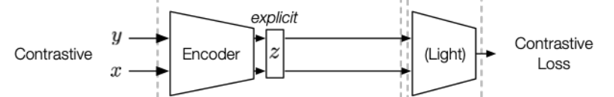
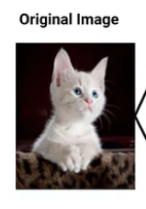
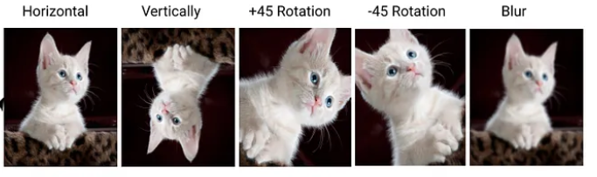


Unsupervised learning: Representation
Constrastive models:
train an encoder to encode input $x$ and $x′$into an explicit vector $z$ to measure similarity
$x′$ from data augmentation, e.g., Rotation, Cropping, Noise addition, Scaling
$$x′$$
21
Notes:
21
一致性

Slide 22
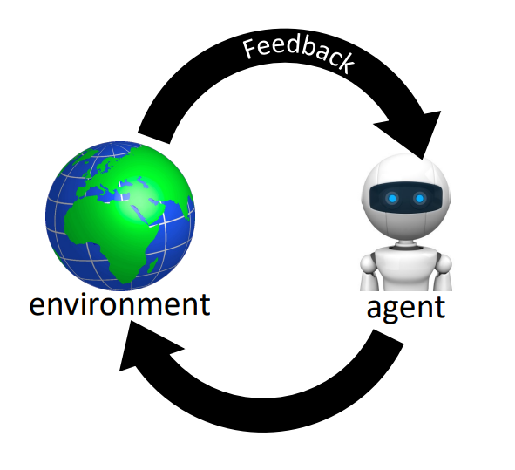
Reinforcement learning
learn how to perform a task from interactions with the environment
Examples:
Playing chess (interact with the game)
Robot grasping an object (interact with the object/real world)
Recommender systems (system interacts with users)
Slide from CIS 4190
22
Notes:
22
一致性

Slide 23
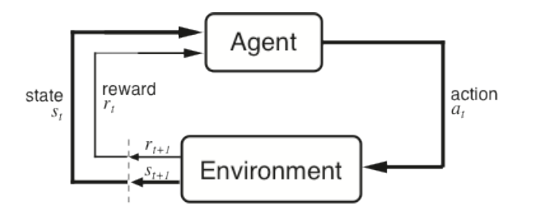
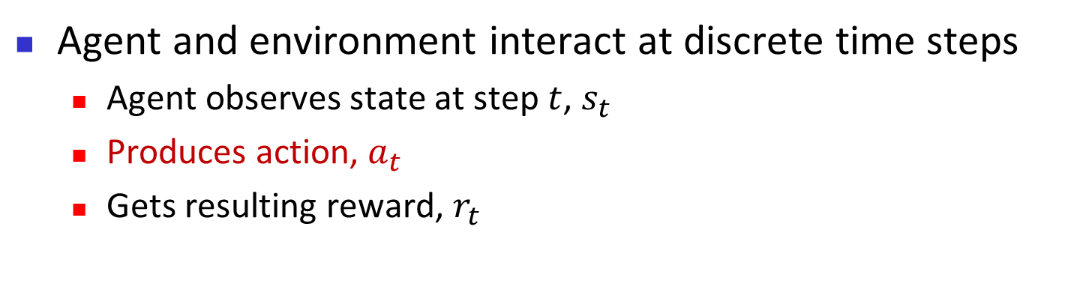
Reinforcement learning
Agent and environment interact at discrete time steps
Agent observes state at step $t$, $s_{t}$
Produces action, $a_{t}$
Gets resulting reward, $r_{t}$
23
Notes:
23
一致性

Slide 24
Basic Machine Learning
Machine learning: basic concepts
Types of learning
Foundation of machine learning
Promising directions
24
Notes:
24

Slide 25
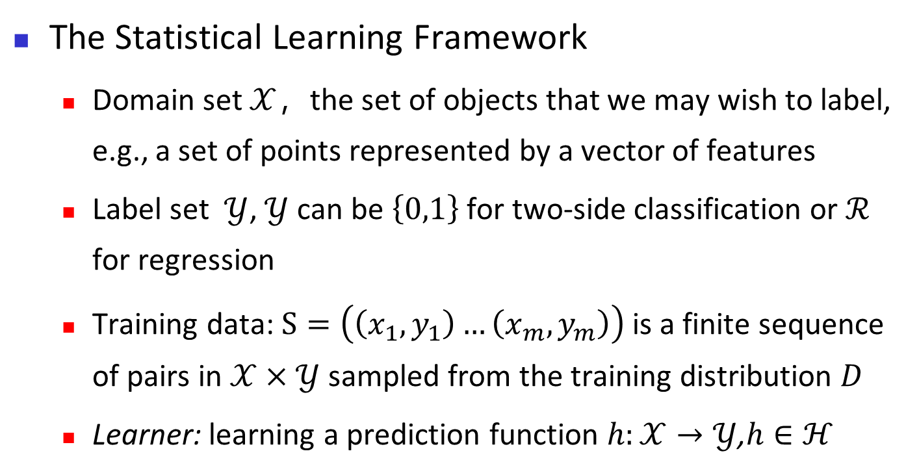
Foundation of machine learning
The Statistical Learning Framework
Domain set $𝒳$，the set of objects that we may wish to label, e.g., a set of points represented by a vector of features
Label set $𝒴$, $𝒴$ can be $\left\{0,1\right\}$for two-side classification or $ℛ$ for regression
Training data: $S=\left(\left(x_{1},y_{1}\right)…\left(x_{m},y_{m}\right)\right)$ is a finite sequence of pairs in $𝒳×𝒴$ sampled from the training distribution $D$
Learner: learning a prediction function $h:𝒳→𝒴$,$h∈ℋ$
Understanding Machine Learning: From Theory to Algorithms
25
Notes:
25

Slide 26
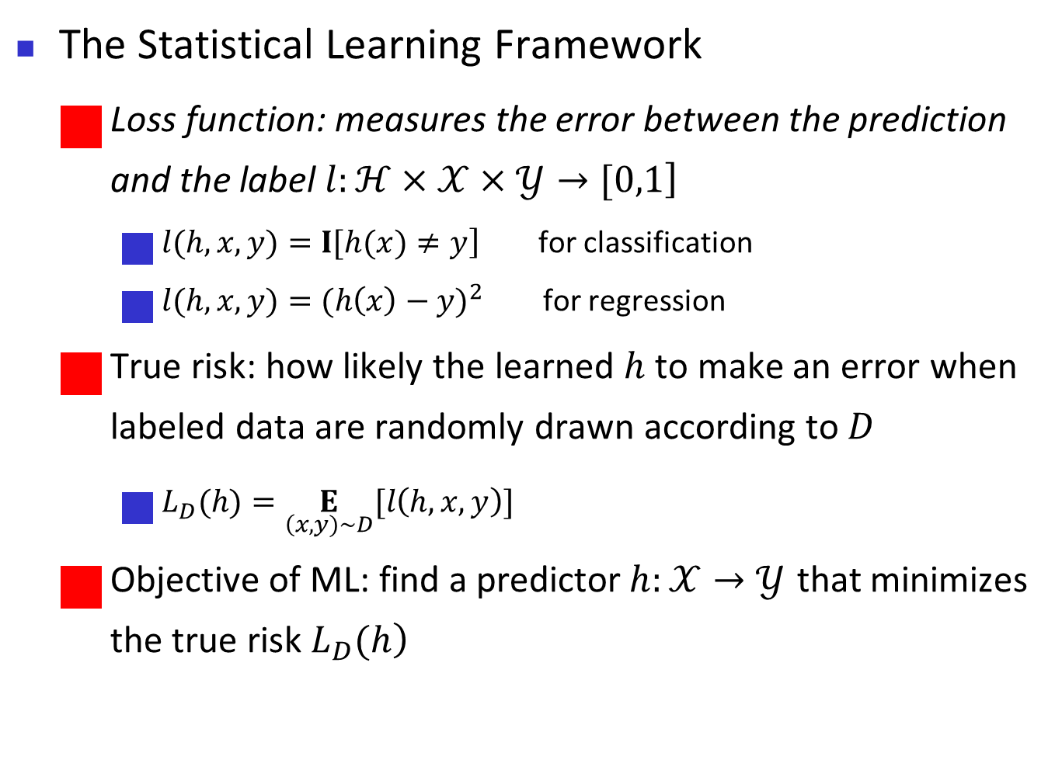
Foundation of machine learning
The Statistical Learning Framework
Loss function: measures the error between the prediction and the label $\left.l:ℋ×𝒳×𝒴→[0,1\right]$
$\left.l(h,x,y)=I[h(x)≠y\right]$ for classification
$l(h,x,y)={(h\left(x\right)−y)}^{2}$ for regression
True risk: how likely the learned $h$ to make an error when labeled data are randomly drawn according to $D$
$L_{D}(h)=\underset{\left(x,y)\sim D\right.}{E}[l\left(h,x,y\right)]$
Objective of ML: find a predictor$h:𝒳→𝒴$ that minimizes the true risk $\left.L_{D}(h\right)$
26
Notes:
26
这一部分内容，居然会介绍一些机器学习最最基础知识。一步一步推导出机器学习的泛华误差的界。 从而帮忙大家更好的理解，包括overfiting、独立同分布假设、inductive bias、bias-variance分解等关键概念。

Slide 27
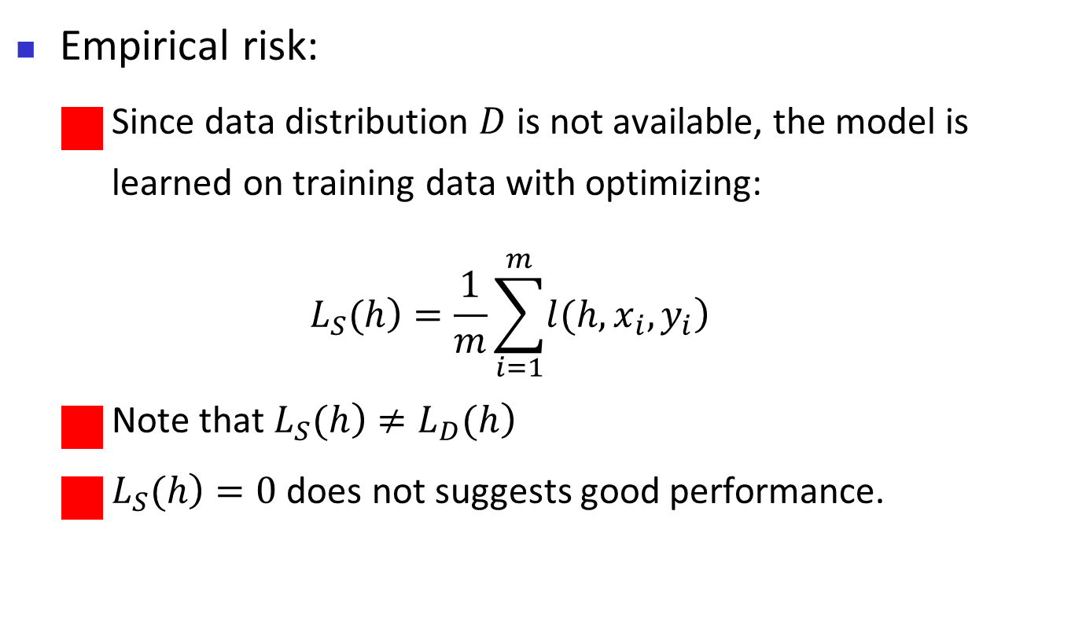
Foundation of machine learning
Empirical risk:
Since data distribution $D$ is not available, the model is learned on training data with optimizing:
$$\left.L_{S}(h\right)=\frac{1}{m}\sum_{i=1}^{m}{\left.l(h,x_{i},y_{i}\right)}$$
Note that $\left.L_{S}(h\right)≠\left.L_{D}(h\right)$
$\left.L_{S}(h\right)=0$ does not suggests good performance.
27
Notes:
27
这一部分内容，居然会介绍一些机器学习最最基础知识。一步一步推导出机器学习的泛华误差的界。 从而帮忙大家更好的理解，包括overfiting、独立同分布假设、inductive bias、bias-variance分解等关键概念。

Slide 28
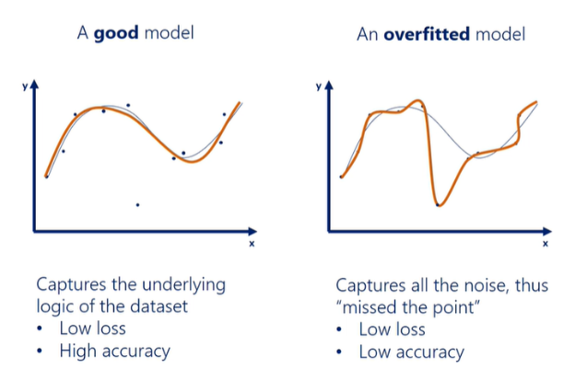
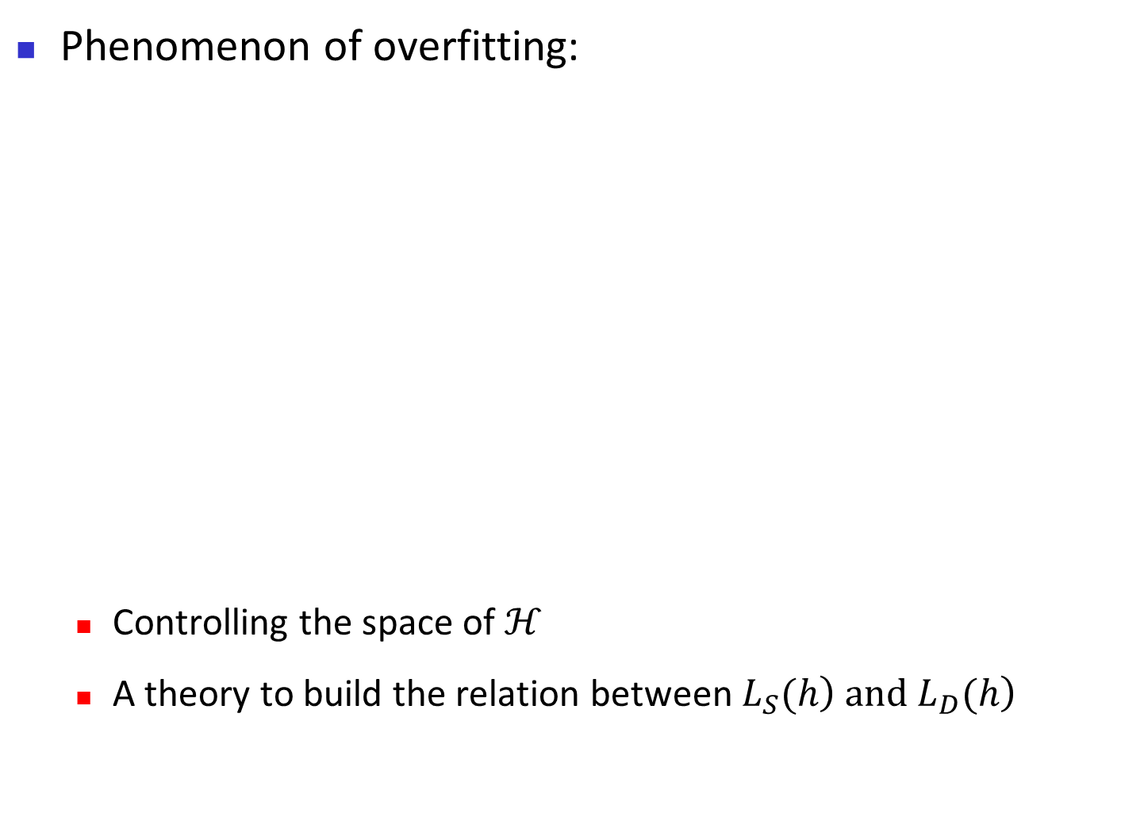
Foundation of machine learning
Phenomenon of overfitting:
Controlling the space of $ℋ$
A theory to build the relation between $\left.L_{S}(h\right)\left.{ and L}_{D}(h\right)$
28
Notes:
28
这里只用了分类的LOSS，回归问题也可以类似定义。

Slide 29

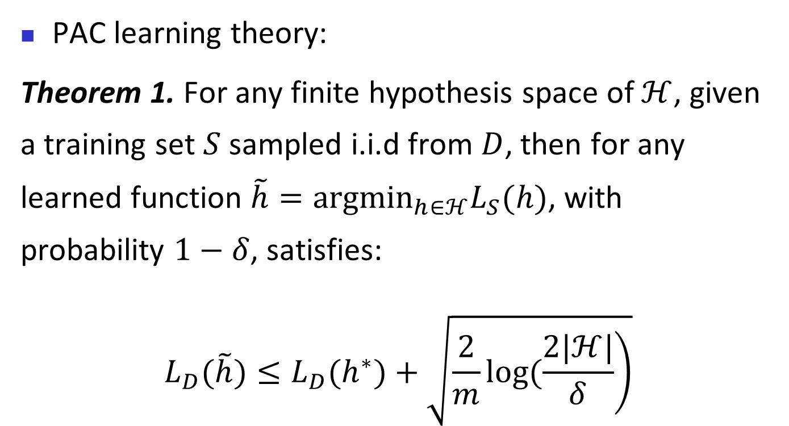
Foundation of machine learning
PAC learning theory:
Theorem 1. For any finite hypothesis space of $ℋ$, given a training set $S$ sampled i.i.d from $D$, then for any learned function $\tilde{h}=arg\min_{h∈ℋ}L_{S}(h)$, with probability $1−δ$, satisfies:
$$L_{D}(\tilde{h})≤L_{D}(h^{∗})+\sqrt{\left.\frac{2}{m}log(\frac{2|ℋ|}{δ}\right)}$$
Where $h^{∗}$denotes the optimal function in $ℋ$with $\left.h^{∗}=arg\min_{h∈ℋ}L_{D}(h\right)$
29
Notes:
29
这里只用了分类的LOSS，回归问题也可以类似定义。

Slide 30
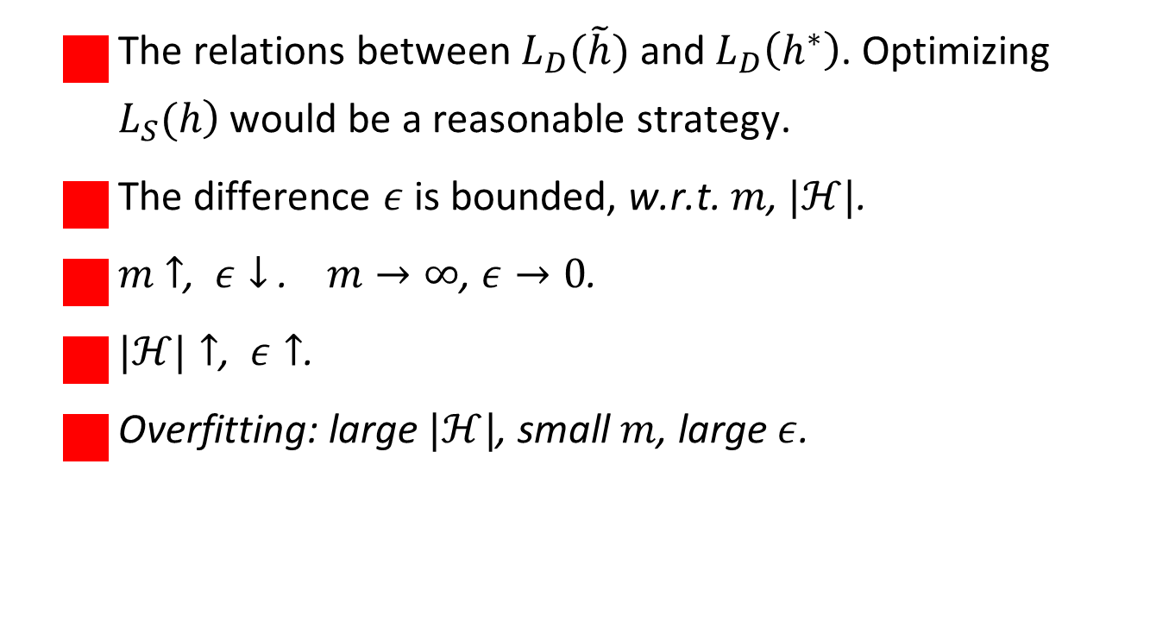
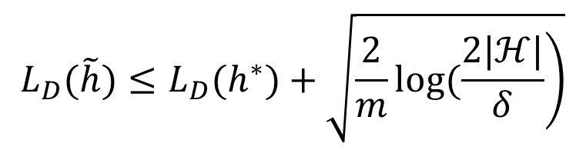
Foundation of machine learning
$$L_{D}(\tilde{h})≤L_{D}(h^{∗})+\sqrt{\left.\frac{2}{m}log(\frac{2|ℋ|}{δ}\right)}$$
The relations between $L_{D}(\tilde{h})$ and $L_{D}\left(h^{∗}\right)$. Optimizing $\left.L_{S}(h\right)$ would be a reasonable strategy.
The difference $ε$ is bounded, w.r.t. $m$, $|ℋ|$.
$m$ $↑$, $ε↓$ . $m→∞$, $ε→0$.
$|ℋ|↑$, $ε↑$.
Overfitting: large $|ℋ|$, small $m$, large $ε$.
30
Notes:
30
这里只用了分类的LOSS，回归问题也可以类似定义。

Slide 31
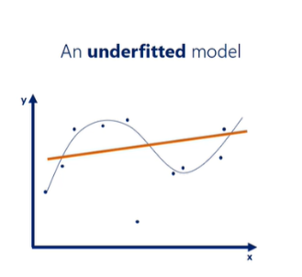
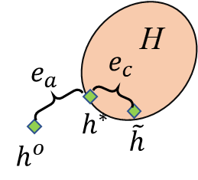
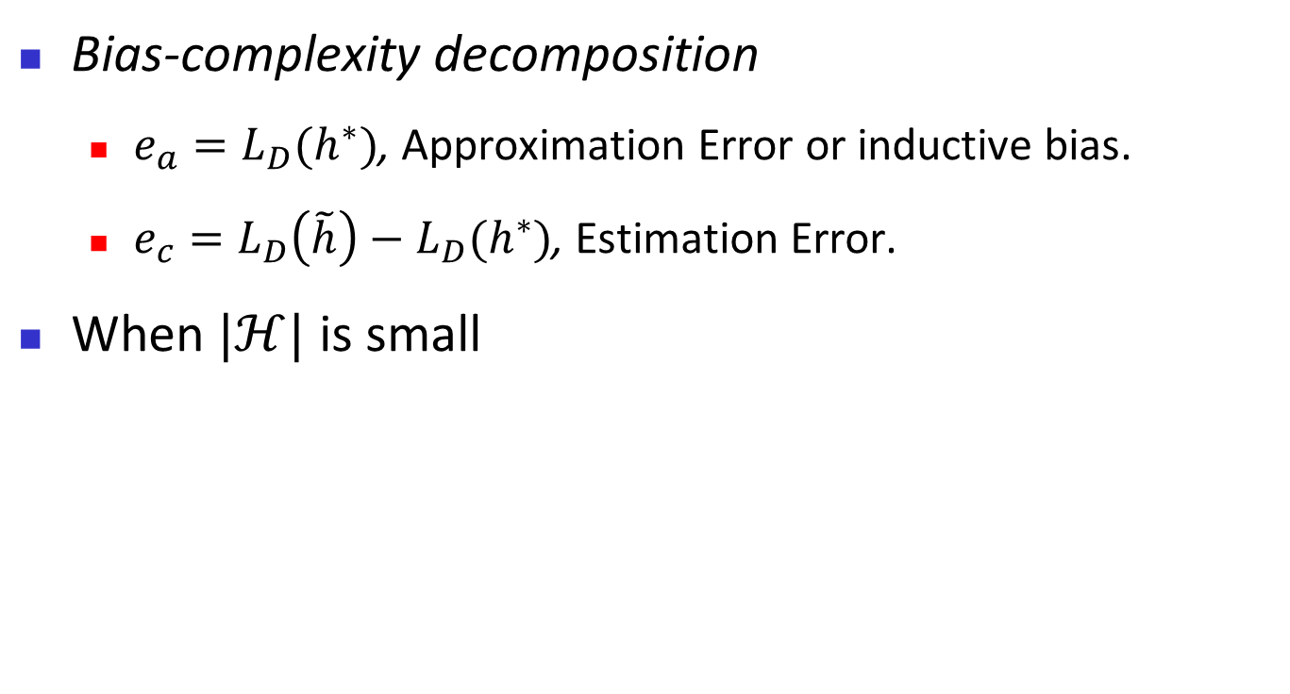
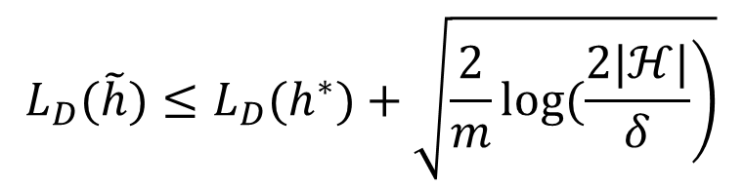
Foundation of machine learning
$$L_{D}(\tilde{h})≤L_{D}(h^{∗})+\sqrt{\left.\frac{2}{m}log(\frac{2|ℋ|}{δ}\right)}$$
Bias-complexity decomposition
$e_{a}=L_{D}(h^{∗})$, Approximation Error or inductive bias.
$e_{c}=L_{D}\left(\tilde{h}\right)−L_{D}(h^{∗})$, Estimation Error.
When $|ℋ|$ is small
31
Notes:
31
首先要说明你提的方法是合理的。 然后公式讲了什么趋势。直接如何理解。 最后，挂钩一下这个公式和你发现或者前人的现象。 解释一下。

Slide 32
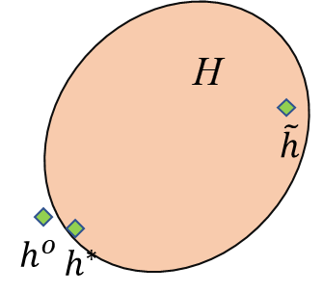
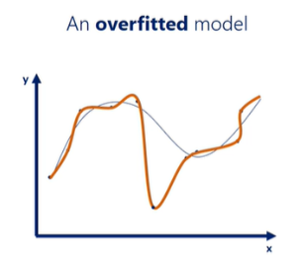
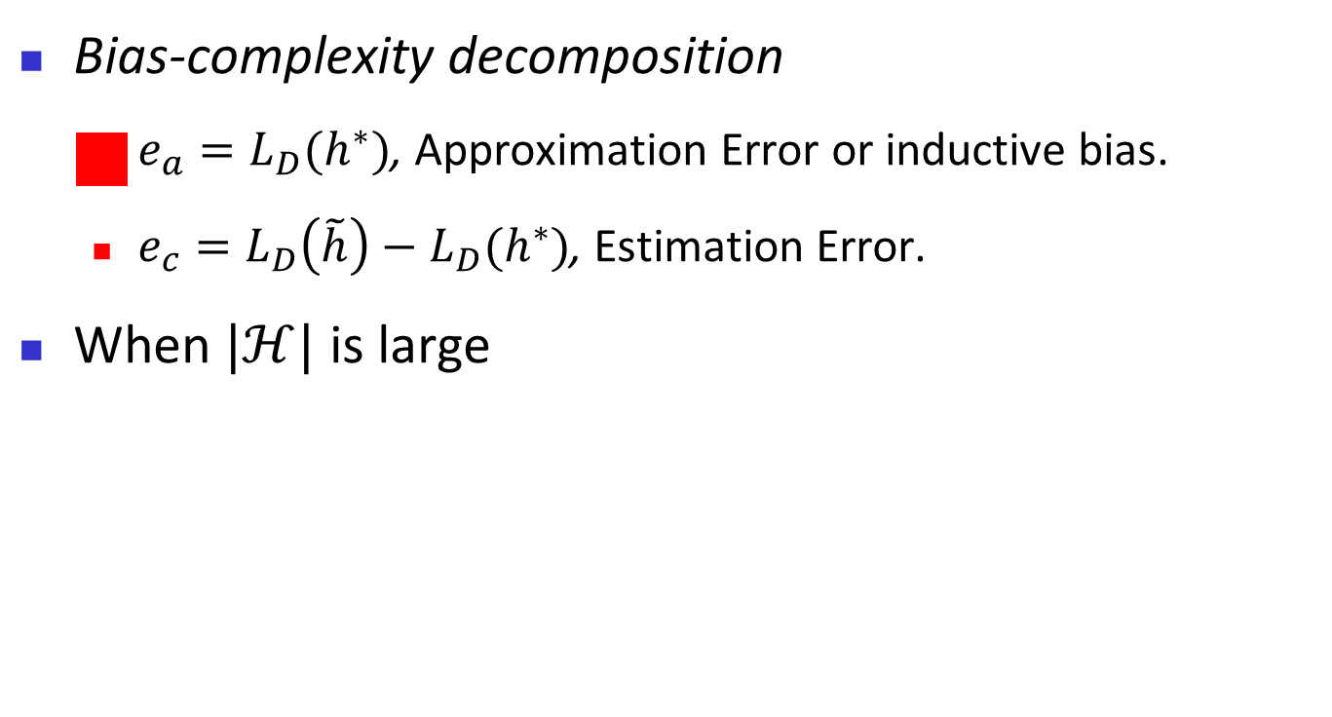
Foundation of machine learning
$$L_{D}(\tilde{h})≤L_{D}(h^{∗})+\sqrt{\left.\frac{2}{m}log(\frac{2|ℋ|}{δ}\right)}$$
Bias-complexity decomposition
$e_{a}=L_{D}(h^{∗})$, Approximation Error or inductive bias.
$e_{c}=L_{D}\left(\tilde{h}\right)−L_{D}(h^{∗})$, Estimation Error.
When $|ℋ|$ is large
32
Notes:
32
首先要说明你提的方法是合理的。 然后公式讲了什么趋势。直接如何理解。 最后，挂钩一下这个公式和你发现或者前人的现象。 解释一下。

Slide 33


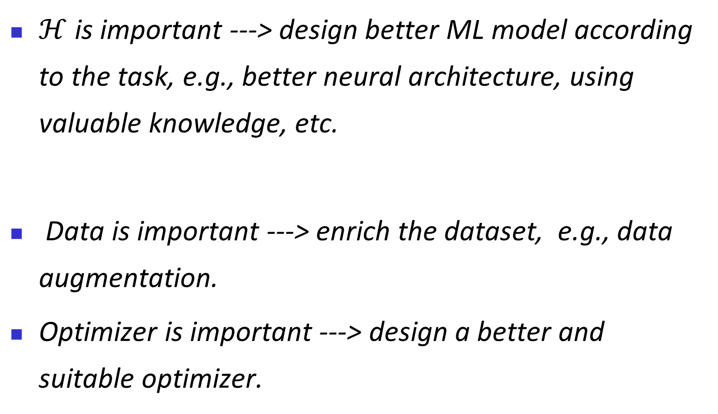
Foundation of machine learning
$ℋ$ is important ---> design better ML model according to the task, e.g., better neural architecture, using valuable knowledge, etc.
Data is important ---> enrich the dataset, e.g., data augmentation.
Optimizer is important ---> design a better and suitable optimizer.
$$\tilde{h}=arg\min_{h∈ℋ}L_{S}(h)$$
33
Notes:
33
首先要说明你提的方法是合理的。 然后公式讲了什么趋势。直接如何理解。 最后，挂钩一下这个公式和你发现或者前人的现象。 解释一下。

Slide 34
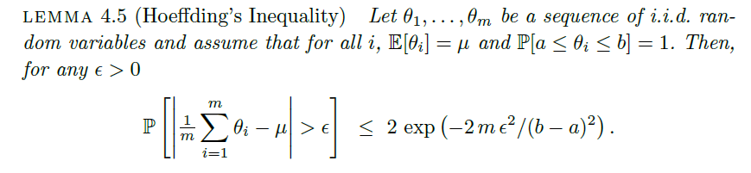

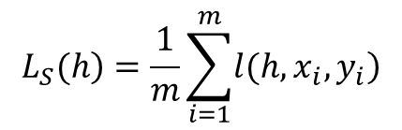
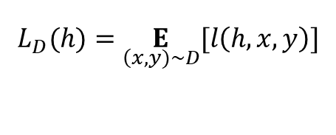
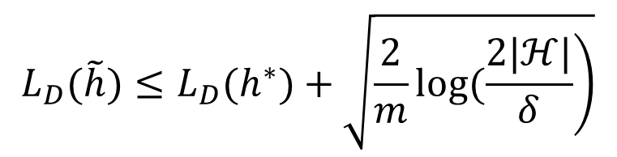
Foundation of machine learning
$$L_{D}(\tilde{h})≤L_{D}(h^{∗})+\sqrt{\left.\frac{2}{m}log(\frac{2|ℋ|}{δ}\right)}$$
Proof of Theorem 1.
Part 1: establish the relations between $L_{D}(h)$ and $L_{S}(h)$.
$$\left.L_{S}(h\right)=\frac{1}{m}\sum_{i=1}^{m}{\left.l(h,x_{i},y_{i}\right)}$$
$$L_{D}(h)=\underset{\left(x,y)\sim D\right.}{E}[l\left(h,x,y\right)]$$
We have: $\left.P(|L_{S}(h)−L_{D}(h)|>ϵ)≤2exp(−2mϵ^{2}\right)$
34
Notes:
34
首先要说明你提的方法是合理的。 然后公式讲了什么趋势。直接如何理解。 最后，挂钩一下这个公式和你发现或者前人的现象。 解释一下。

Slide 35

Foundation of machine learning
$$L_{D}(\tilde{h})≤L_{D}(h^{∗})+\sqrt{\left.\frac{2}{m}log(\frac{2|ℋ|}{δ}\right)}$$
Proof of Theorem 1.
Based on $\left.P(|L_{S}(h)−L_{D}(h)|>ϵ)≤2exp(−2mϵ^{2}\right)$
We further have:
$P(\{∃h∈ℋ,|L_{S}(h)−L_{D}(h)|>ϵ\})$ $≤2\left|ℋ\right|exp\left(−2mϵ^{2}\right)$
due to the fact: $P(A_{1}∪A_{2}…∪A_{n})≤\sum_{i=1}^{n}{\left.P(A_{i}\right)}$
Thus, we have:
$P(\{∀h∈ℋ,|L_{S}(h)−L_{D}(h)|≤ϵ\})$ $>1−δ$
Where $δ=2\left|ℋ\right|exp\left(−2mϵ^{2}\right)$
35
Notes:
35
首先要说明你提的方法是合理的。 然后公式讲了什么趋势。直接如何理解。 最后，挂钩一下这个公式和你发现或者前人的现象。 解释一下。

Slide 36
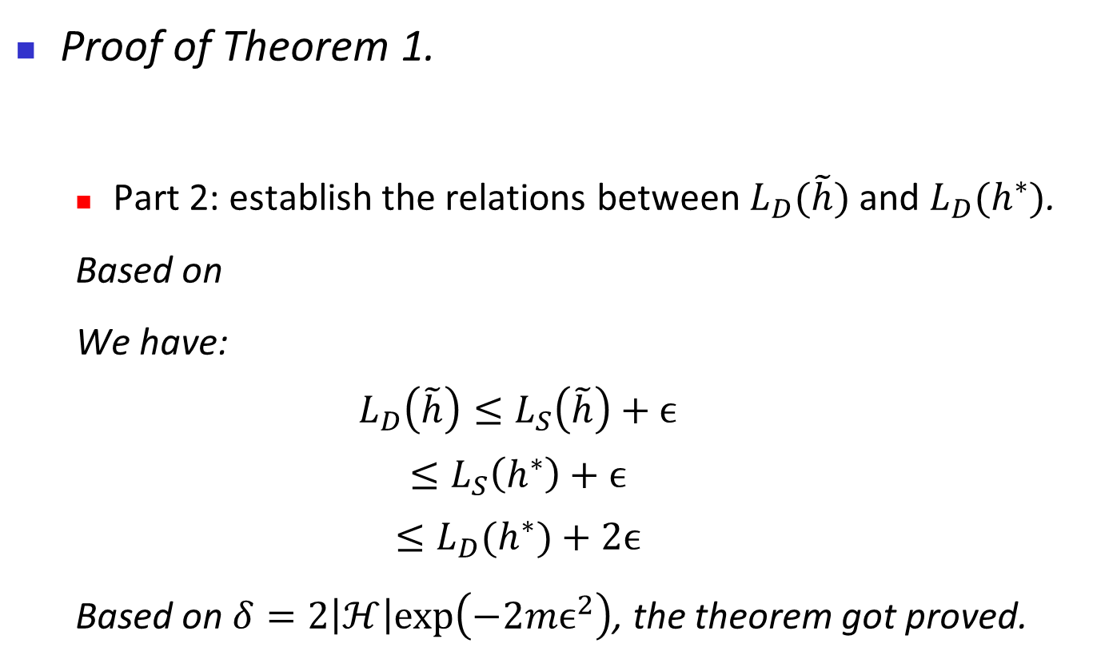

Foundation of machine learning
$$L_{D}(\tilde{h})≤L_{D}(h^{∗})+\sqrt{\left.\frac{2}{m}log(\frac{2|ℋ|}{δ}\right)}$$
Proof of Theorem 1.
Part 2: establish the relations between $L_{D}(\tilde{h})$ and $L_{D}(h^{∗})$.
Based on
We have:
$$L_{D}\left(\tilde{h}\right)≤L_{S}\left(\tilde{h}\right)+ϵ$$
$$≤L_{S}\left(h^{∗}\right)+ϵ$$
$$≤L_{D}(h^{∗})+2ϵ$$
Based on$δ=2\left|ℋ\right|exp\left(−2mϵ^{2}\right)$, the theorem got proved.
$$|L_{S}(h)−L_{D}(h)|≤ϵ$$
36
Notes:
36
首先要说明你提的方法是合理的。 然后公式讲了什么趋势。直接如何理解。 最后，挂钩一下这个公式和你发现或者前人的现象。 解释一下。

Slide 37
Basic Machine Learning
Machine learning: basic concepts
Types of learning
Foundation of machine learning
Promising directions
37
Notes:
37

Slide 38
Promising directions
Model robustness
Distribution shift
Noisy data
Attacks
Long-tailed data
Outliers
Tailored for specific model and task
38
Notes:
38

Slide 39
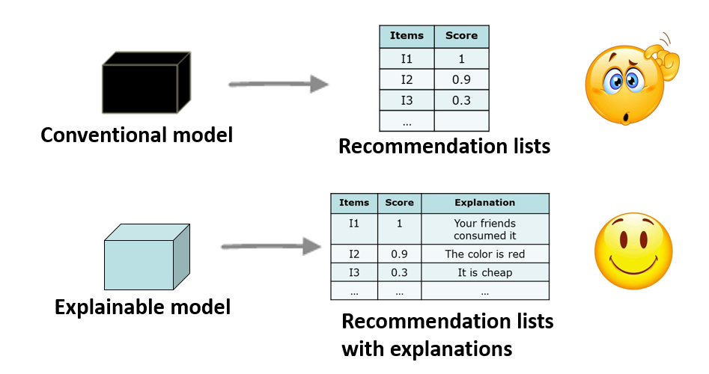
Promising directions
Model interpretability and Explainability
Interpretability is the degree to which a human can understand the cause of a decision
Understanding mechanism of deep model or LLM
Let ML model explain the behavior in human terms
39
Notes:
39

Slide 40
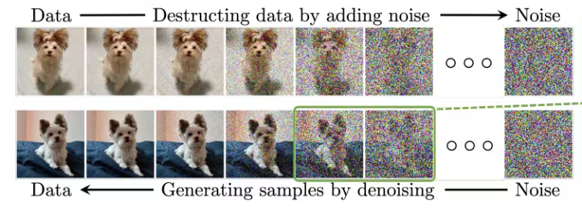
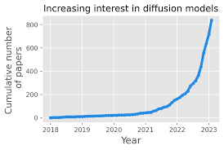
Promising directions
Diffusion model
Diffusion models offer several advantages over traditional generative models
Becomes very hot topic
Many things can be done
40
Notes:
40

Slide 41

Promising directions
Large language model
Prompt
Fine-tuning
Empirical & Theoretical analyses
Application
41
Notes:
41

Slide 42
Promising directions
Large language model
Prompt
Fine-tuning
Empirical & Theoretical analyses
Application
42
Notes:
42

Slide 43

Machine Learning
Thank you!
43
Notes:
43

